Slide 1

Welcome to Sabbath School
Illustration by Jo Card. Copyright © 2024 General Conference Corporation® of Seventh-day Adventists.

Slide 2

EARLY ARRIVALS
EARLY
ARRIVALS

Slide 3

Books of the Bible
EARLY ARRIVALS
EARLY
ARRIVALS

Slide 4
Welcome to Sabbath School
Illustration by Jo Card. Copyright © 2024 General Conference Corporation® of Seventh-day Adventists.

Slide 5

God’s Love
OPENING ACTIVITIES
God’s love is for (clap) all people (clap),
All people, wherever they are.
God’s love is for (clap) all people,
Yes, God loves us all.
(Continued on next slide)

Slide 6
OPENING ACTIVITIES
God’s Love
He loves the small ones.
He loves the tall ones,
The moms and the dads
And the babies, too.
The sisters and the brothers
And all of the others,
God’s love is for you.
(Continued on next slide)

Slide 7
God’s Love
OPENING ACTIVITIES
One, two, three, four!
God’s joy is for (clap) all people (clap),
All people, wherever they are.
God’s joy is for (clap) all people.
Yes, God loves us all.
(Continued on next slide)

Slide 8
OPENING ACTIVITIES
God’s Love
He loves the small ones.
He loves the tall ones,
The moms and the dads
And the babies, too.
The sisters and the brothers
And all of the others,
God’s love is for you.
(Continued on next slide)

Slide 9
OPENING ACTIVITIES
God’s Love
One, two, three, four!
God’s peace is for (clap)all people (clap),
All people, wherever they are.
God’s peace is for (clap) all people.
Yes, God loves us all.
Yes, God loves us all.
"God's Love" by Kimberly Houliston, copyright © 2001 Abide Family Ministries. Used by permission.

Slide 10
Be Kind
OPENING ACTIVITIES
What you choose to do today
Can impact on others,
Maybe even hurt your sisters
And your brothers.
So think carefully about
What you say and what you do.
Choose what’s good.
Think of others ev’ry day.
(Continued on next slide)

Slide 11
Be Kind
OPENING ACTIVITIES
Choose what’s good.
Choose what’s right.
Think of the good things you can do And always do what’s right
Because you can make a difference,
You can let your light shine.
Ask Jesus to help you to be kind.
(Continued on next slide)

Slide 12
Be Kind
OPENING ACTIVITIES
What you choose to do today
Can impact on others,
Maybe even hurt your sisters
And your brothers.
So think carefully about
What you say and what you do.
Choose what’s good.
Think of others ev’ry day.
(Continued on next slide)

Slide 13
Be Kind
OPENING ACTIVITIES
Choose what’s good.
Choose what’s right.
Think of the good things you can do And always do what’s right
Because you can make a difference,
You can let your light shine.
Ask Jesus to help you to be kind.
(Continued on next slide)

Slide 14
Be Kind
OPENING ACTIVITIES
Choose what’s good.
Choose what’s right.
Think of the good things you can do And always do what’s right
Because you can make a difference,
You can let your light shine.
Ask Jesus to help you to be kind.
Ask Jesus to help you to be kind.
"Be Kind" by Kimberly Houliston, copyright © 2022 Abide Family Ministries. Used by permission.

Slide 15
Sabbath Song
OPENING ACTIVITIES
He made us, He saved us,
He’s coming back to take us home.
(Repeat two times)
Jesus, You are welcome in this place.
Father, You are welcome in this space.
Holy Spirit, fill our hearts with grace.
In this palace of time and space.
(Repeat above)
In this palace of time and space.
"Sabbath Song" by Alexandria and Leighton Heise, copyright © 2020, Alexandria and Leighton Heise. Used by permission.

Slide 16
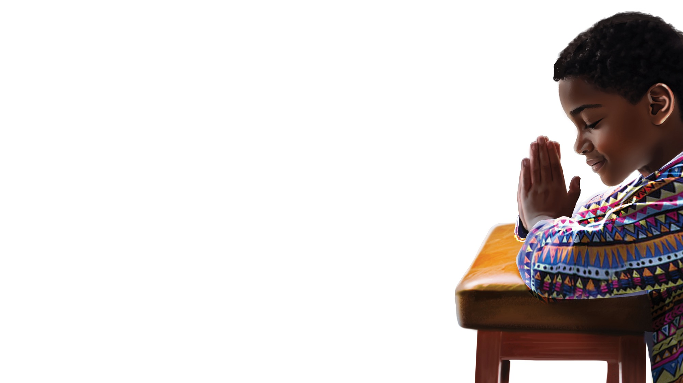
PRAYER
PRAYER

Slide 17
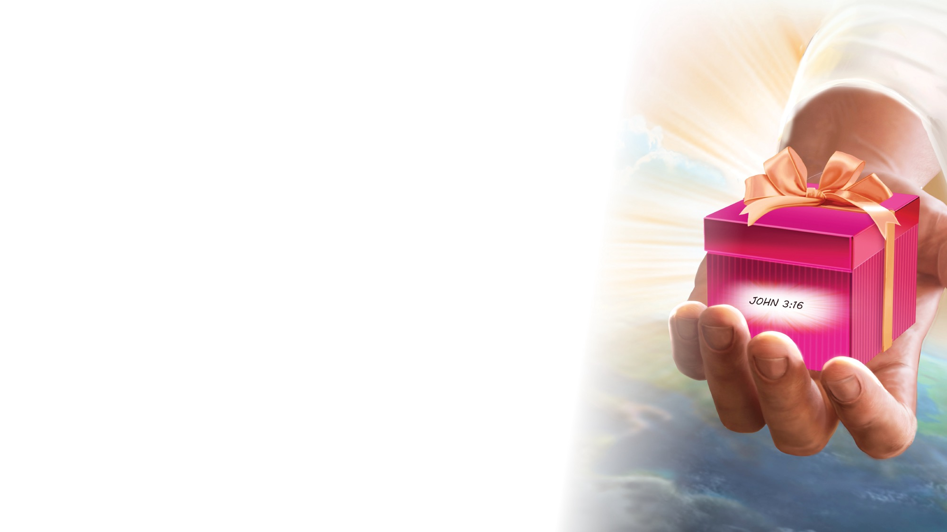
OFFERING

Slide 18

Thank You, Jesus
OPENING ACTIVITIES
Thank you, Jesus
For providing all my needs.
I want to give a little back
Of what you’ve given me.
Please bless our
Sabbath School offering.
May it bring You glory
And help others in need.
(Repeat above)
May it bring You glory
And help others in need.
"Thank You, Jesus" by Rosie Smith, copyright © 2024 General Conference Corporation® of Seventh-day Adventists.

Slide 19
MISSION
FAST FACT &
OFFERING
CHART

Slide 20
Visitor Song
OPENING ACTIVITIES
We have a new friend
With us today.
We have a new friend.
Let’s smile and wave.
We welcome you to Sabbath School.
We’re glad you came.
We welcome you,
And hope to see you again. (x2)
“Visitor Song” by Rosie Smith. Copyright © 2025 General Conference Corporation® of Seventh-day Adventists.

Slide 21
Happy Birthday
OPENING ACTIVITIES
Happy birthday, happy birthday,
Happy birthday to you.
Jesus loves you dear ___________.
Happy birthday to you.
(Repeat above)
“Happy Birthday” by Janet Sage, copyright © 2001 North American Division Corporation of Seventh-day Adventists. From Little Voices Praise Him, #39. Used by permission.

Slide 22

FOCUS
ACTIVITIES

Slide 23
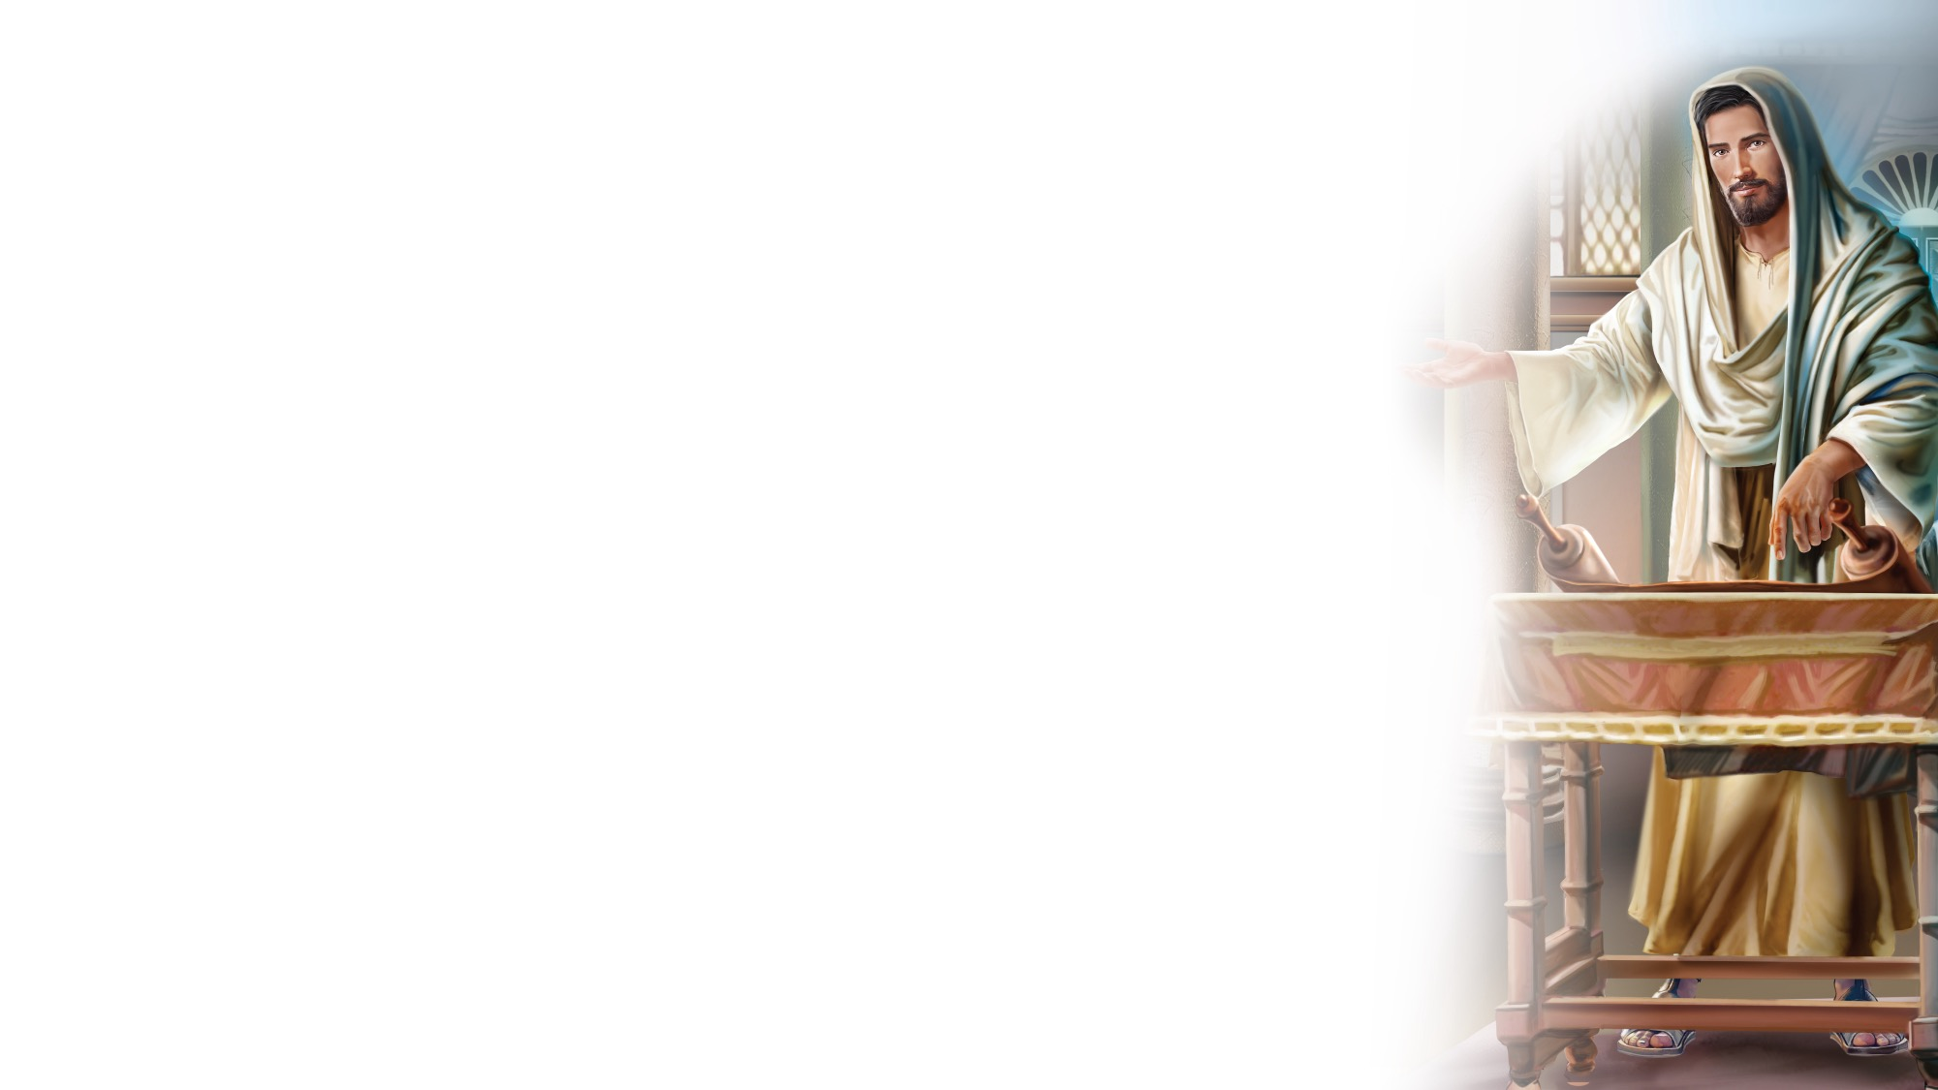
BIG IDEA
When Jesus
blesses my life in wonderful ways,
I can pass a blessing on to others.

Slide 24

BIBLE
STORY

Slide 25
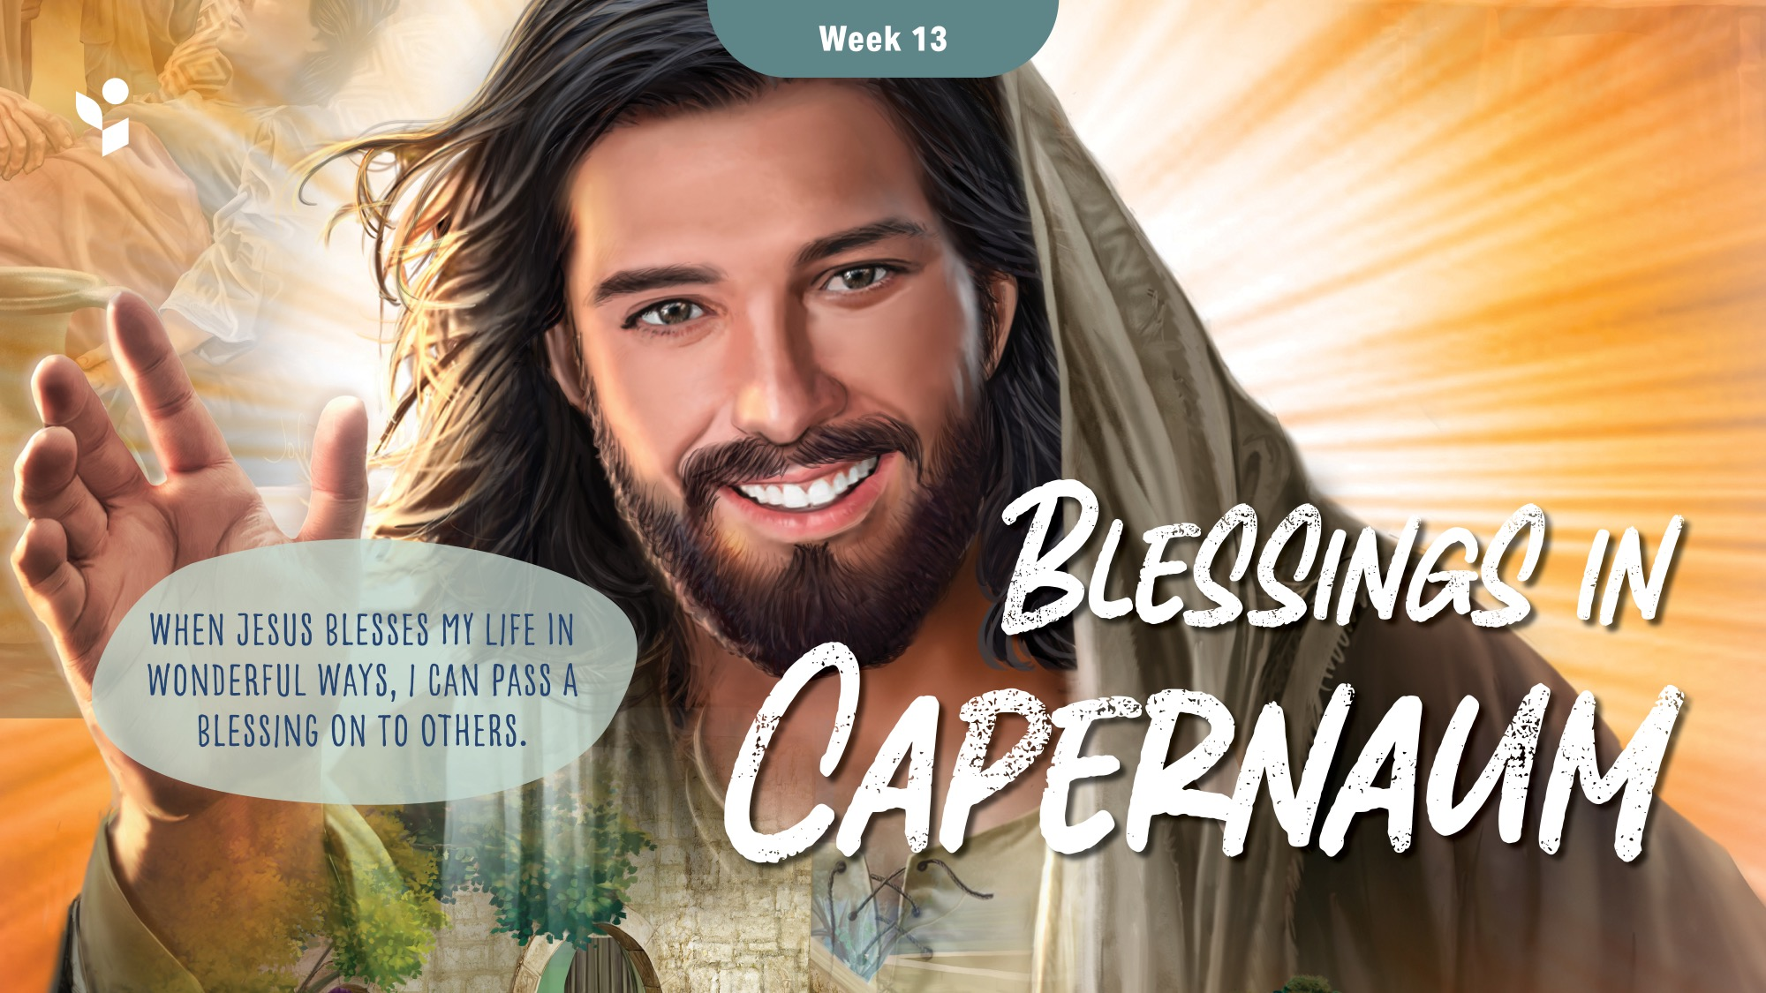

Slide 26
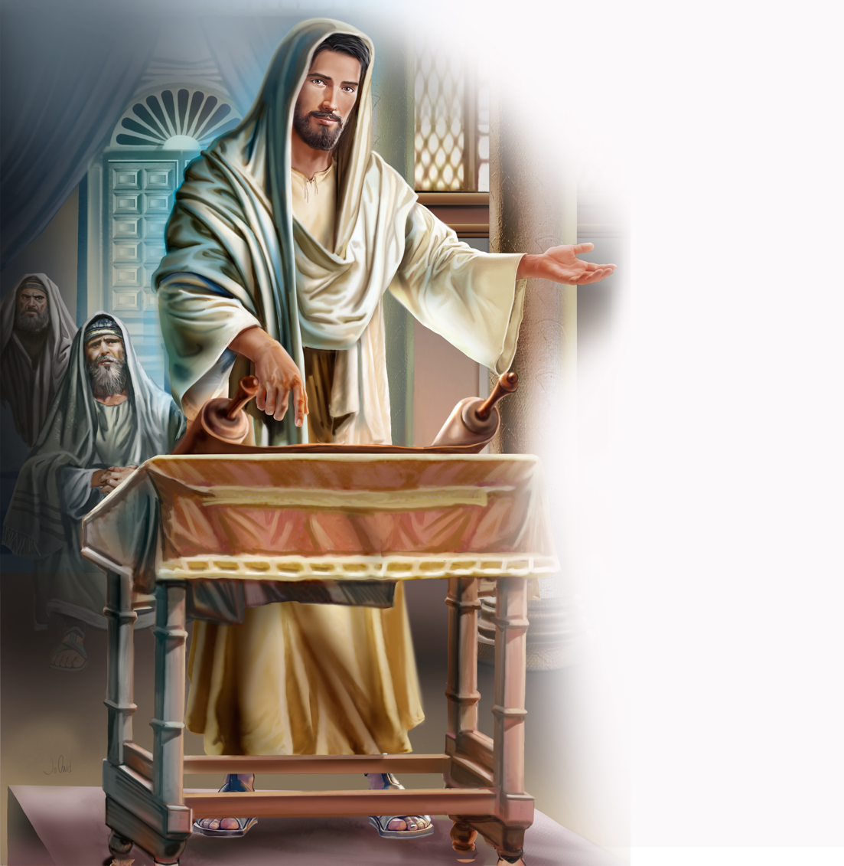
Illustration by Jo Card. Copyright © 2024 General Conference Corporation® of Seventh-day Adventists.

Slide 27
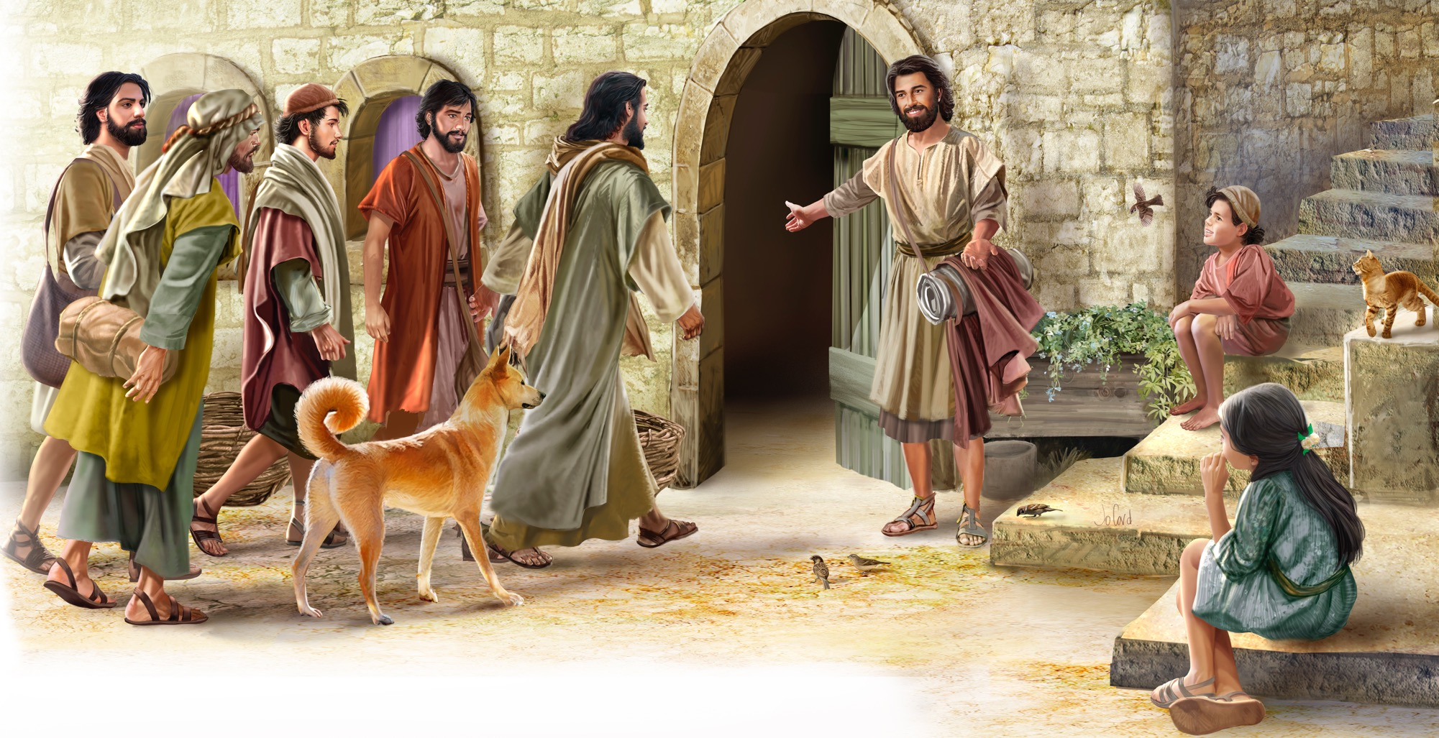
Illustration by Jo Card. Copyright © 2024 General Conference Corporation® of Seventh-day Adventists.

Slide 28
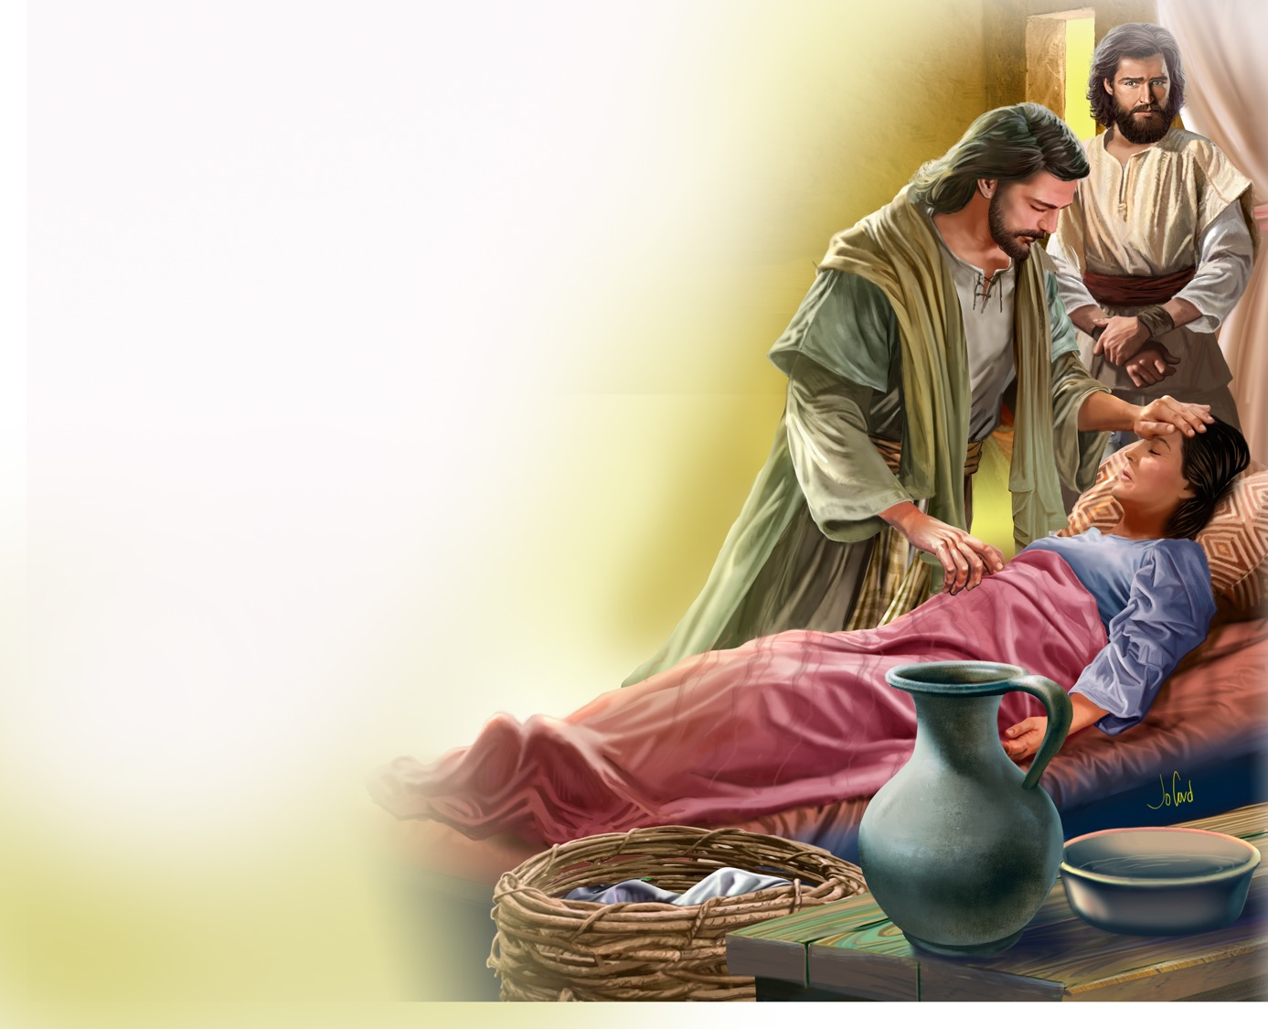
Illustration by Jo Card. Copyright © 2024 General Conference Corporation® of Seventh-day Adventists.

Slide 29
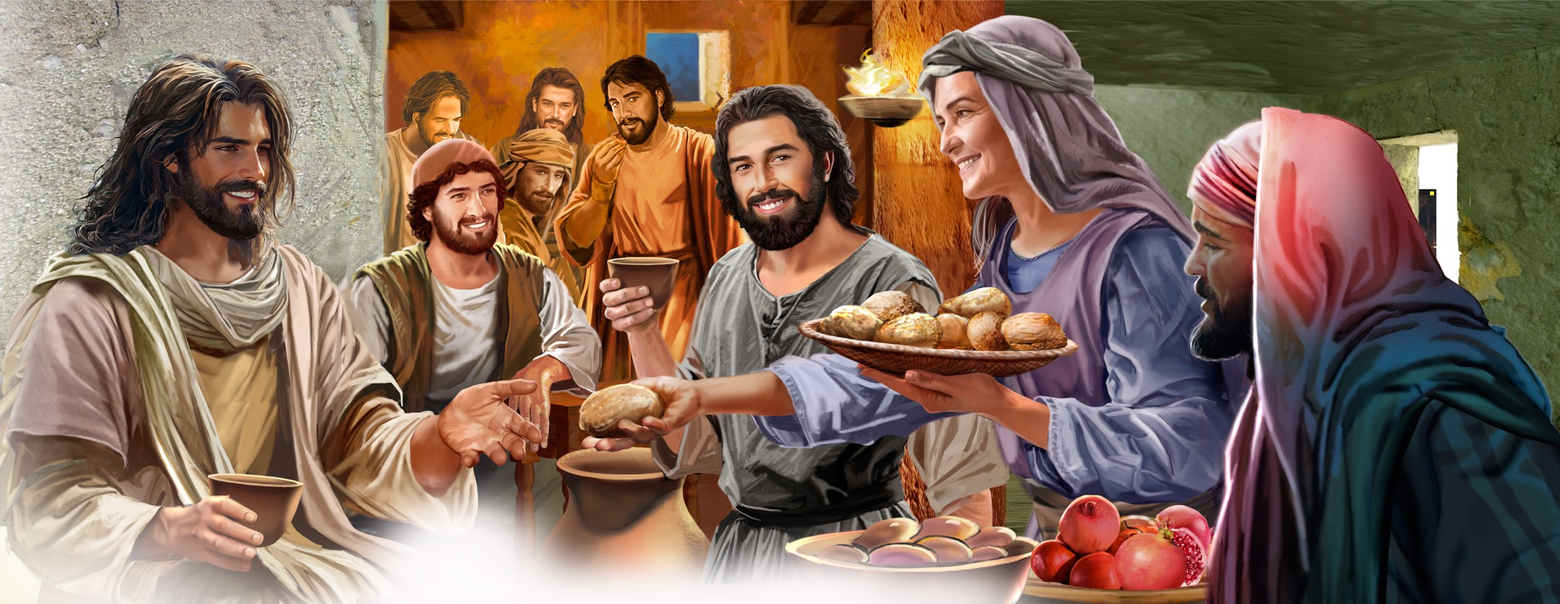
Illustration by Jo Card. Copyright © 2024 General Conference Corporation® of Seventh-day Adventists.

Slide 30
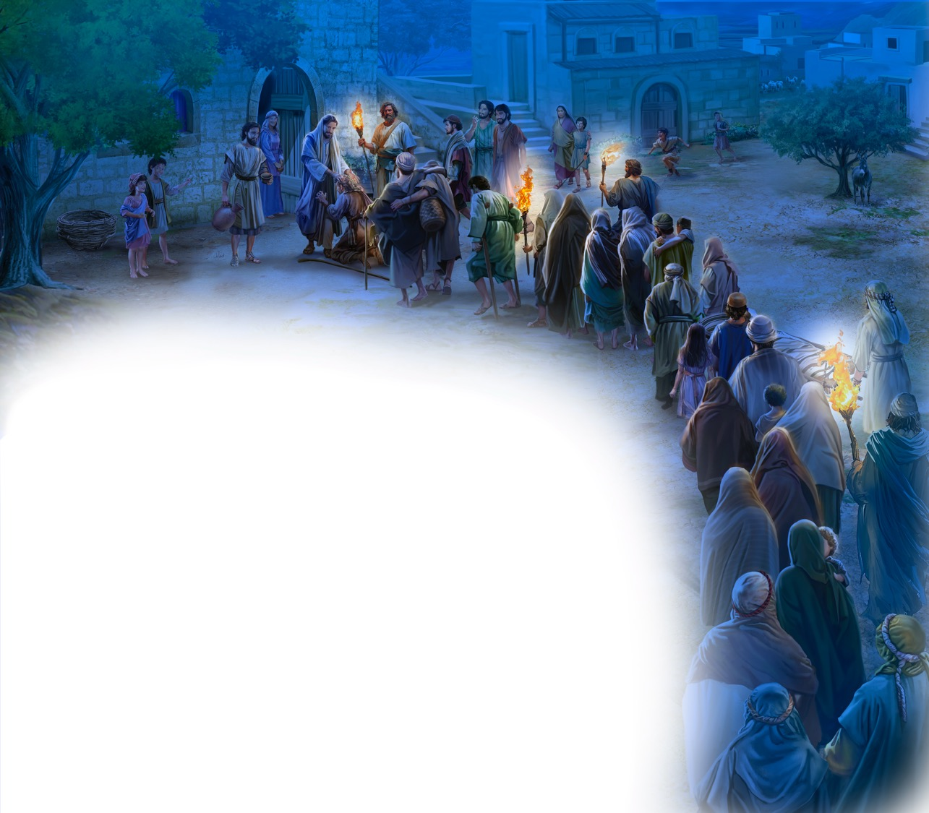
Illustration by Jo Card. Copyright © 2024 General Conference Corporation® of Seventh-day Adventists.

Slide 31
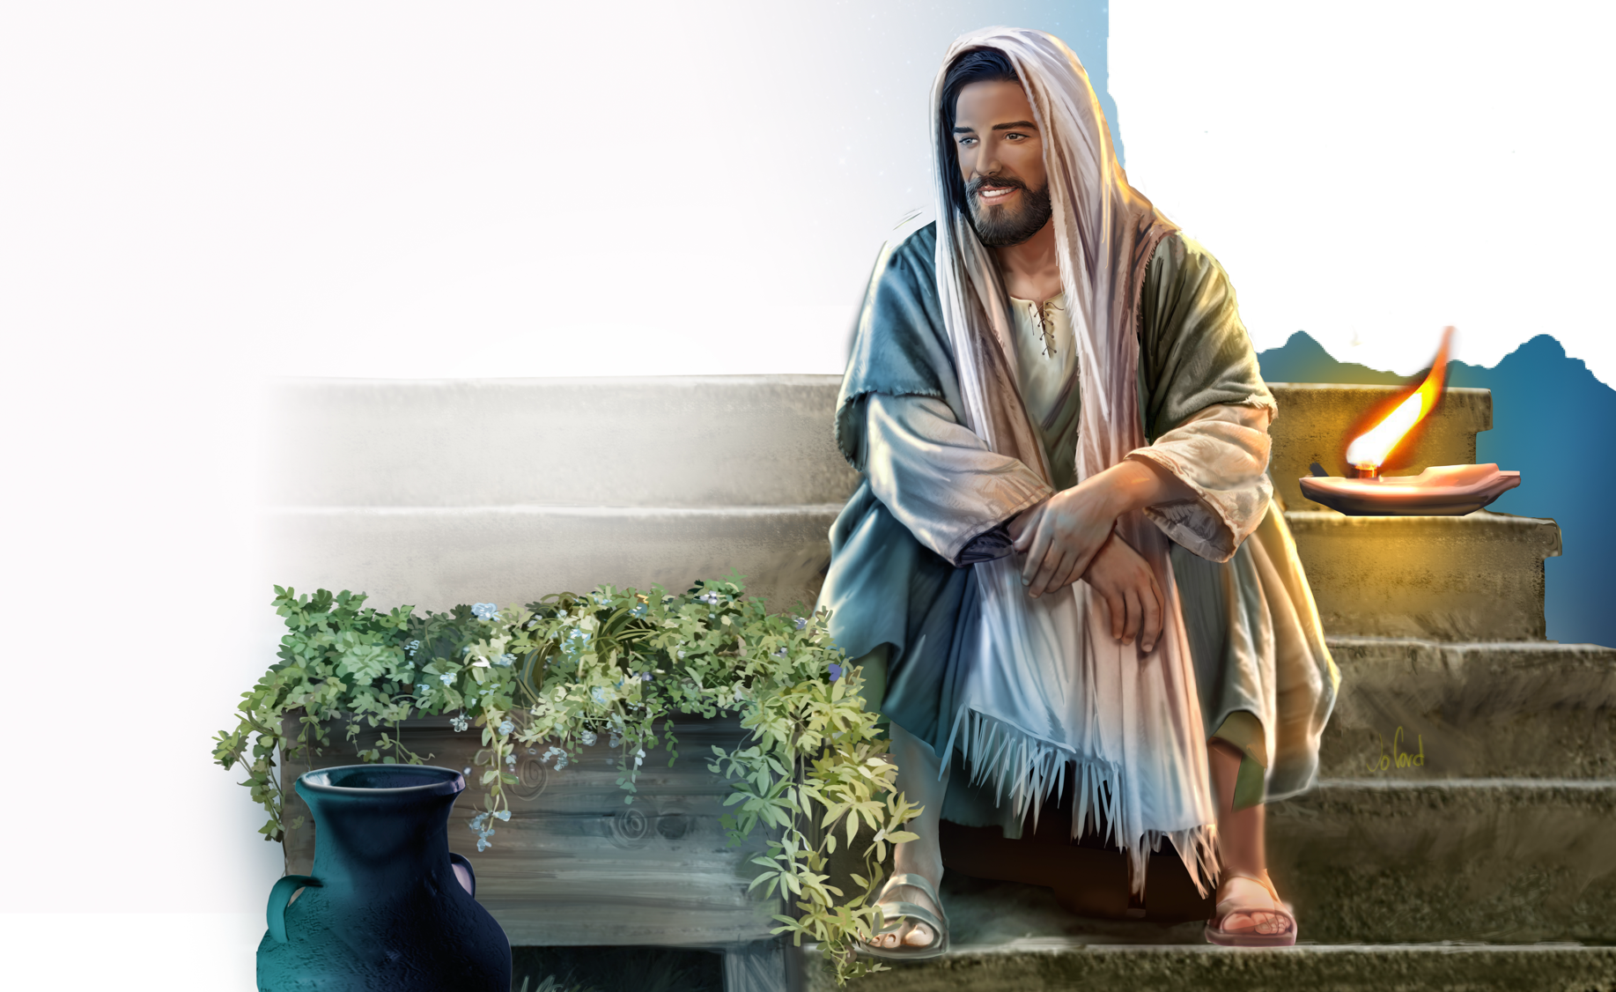
Illustration by Jo Card. Copyright © 2024 General Conference Corporation® of Seventh-day Adventists.

Slide 32
UNPACK
THE STORY

Slide 33

CHARACTER CARDS

Slide 34
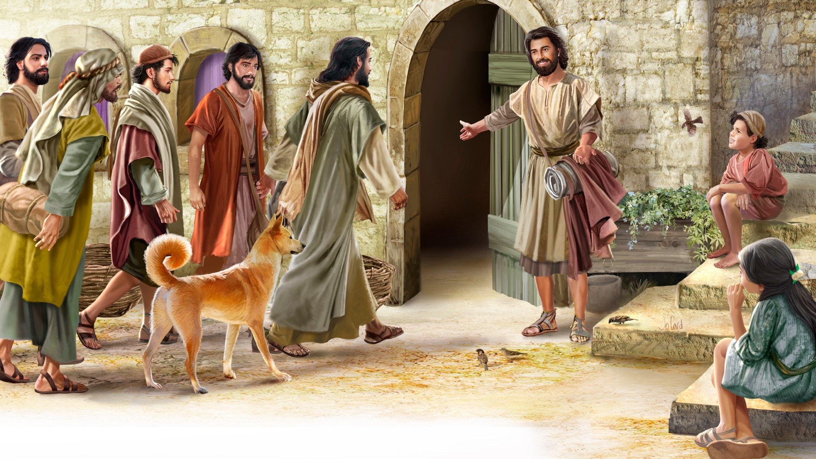
MEMORY VERSE
“The Lord bless you and keep you;
the Lord make His face shine upon you,
and be gracious to you.” Numbers 6:24, 25

Slide 35
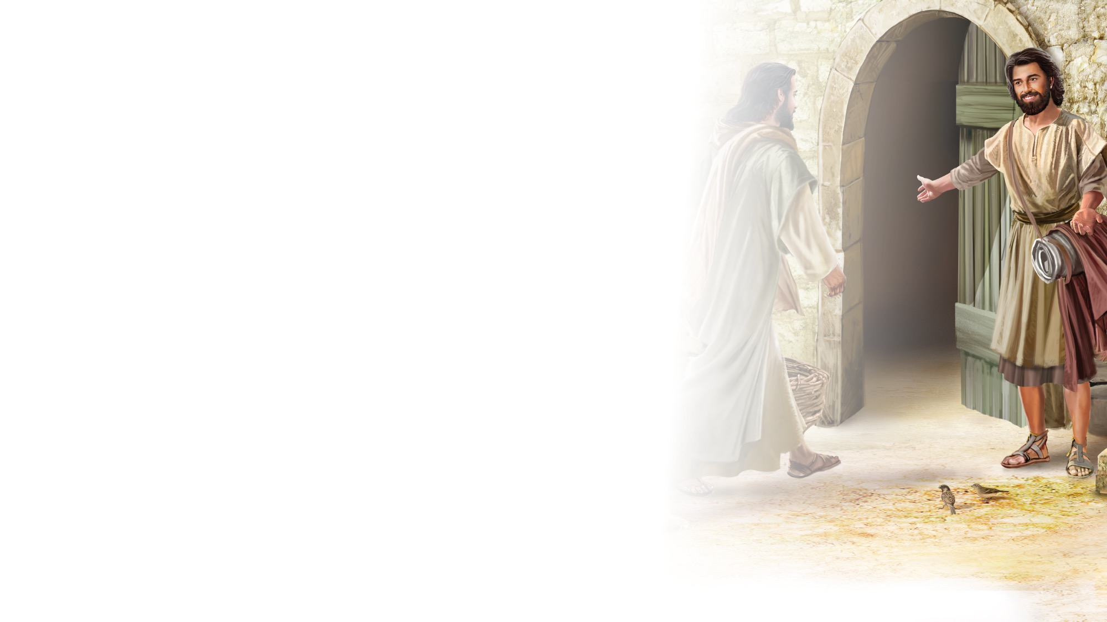
Numbers 6:24,25
SCRIPTURE SONG
The Lord bless you and keep you.
The Lord make His face
Shine upon you,
And be gracious to you.
Numbers 6 verse 24 and 25.
(Repeat above)
"Numbers 6:24, 25" music by Rosie Smith, copyright © 2026 General Conference Corporation® of Seventh-day Adventists.

Slide 36

MISSION
STORY

Slide 37

CRAFT

Slide 38
MISSION
CHALLENGE

Slide 39
BIG IDEA
When Jesus
blesses my life in wonderful ways,
I can pass a blessing on to others.

Slide 40

PRAYER
PRAYER

